Slide 1
Machine Learning

Slide 2
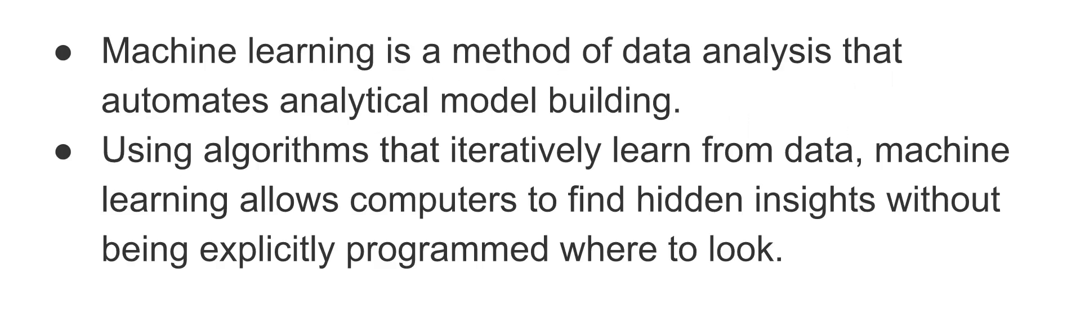
What is Machine Learning?

Slide 3
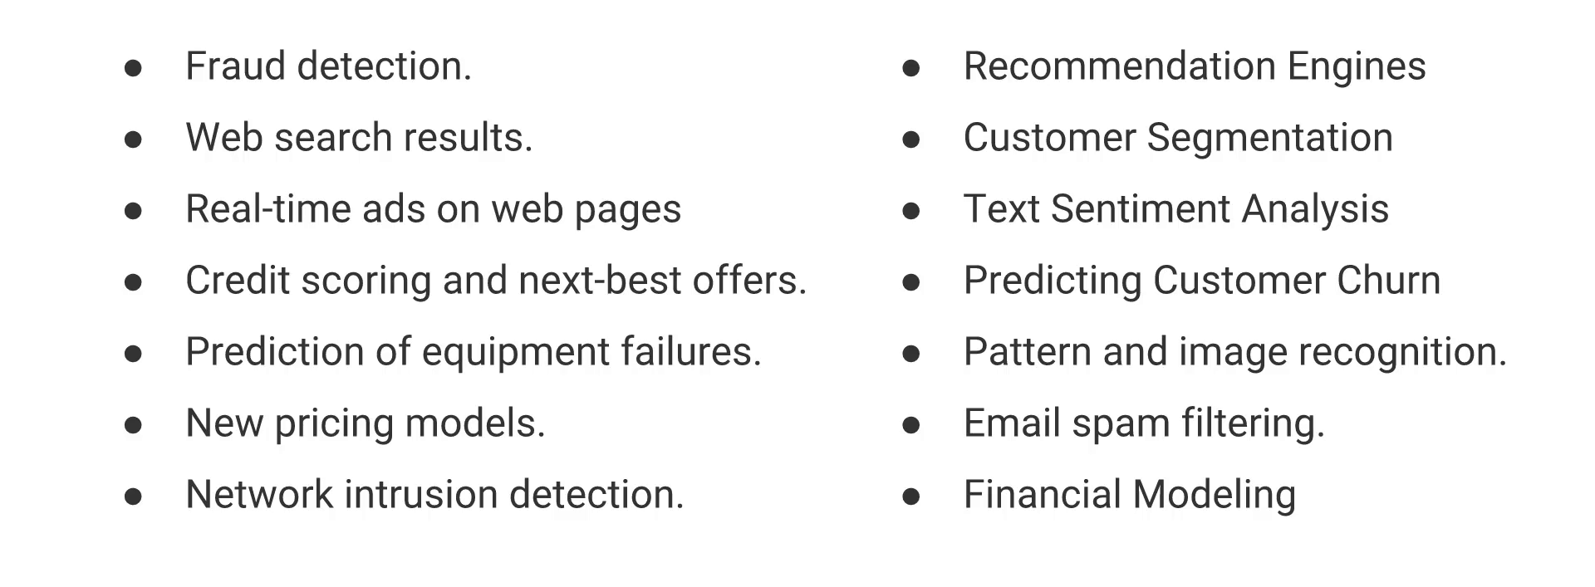
Where it is used?

Slide 4
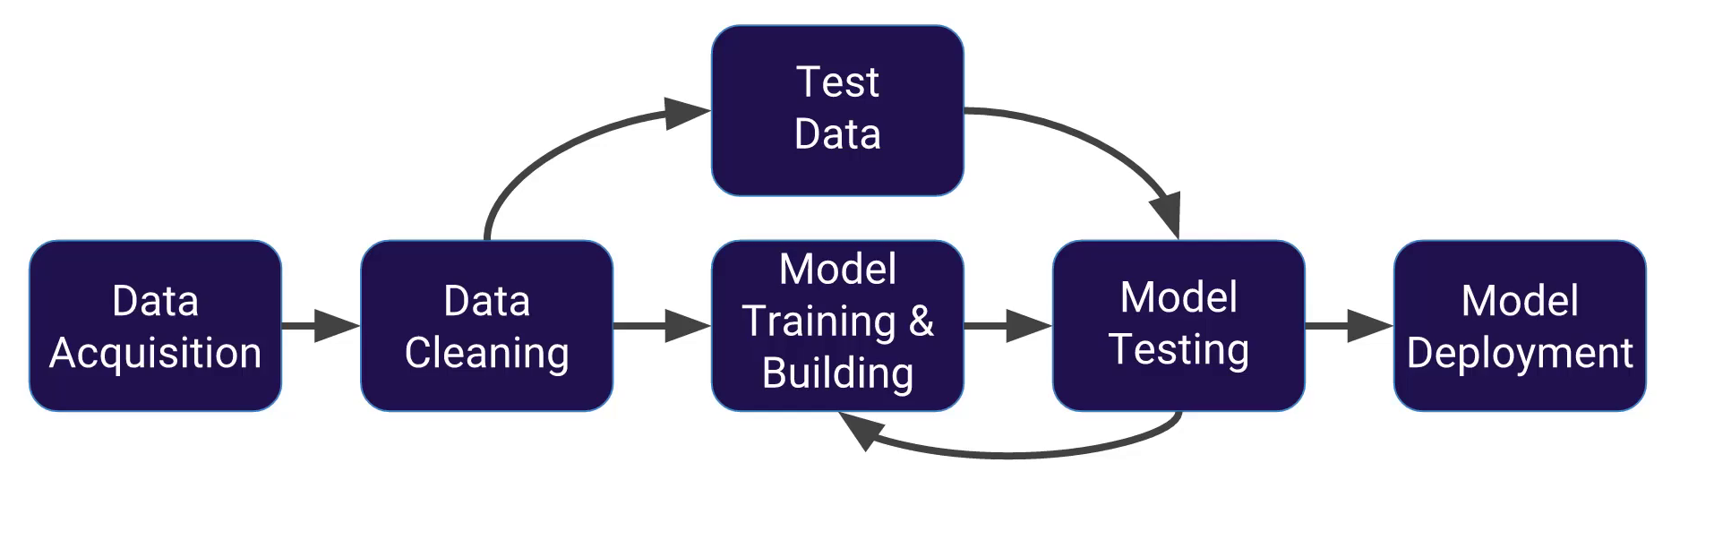
Machine Learning Flow

Slide 5
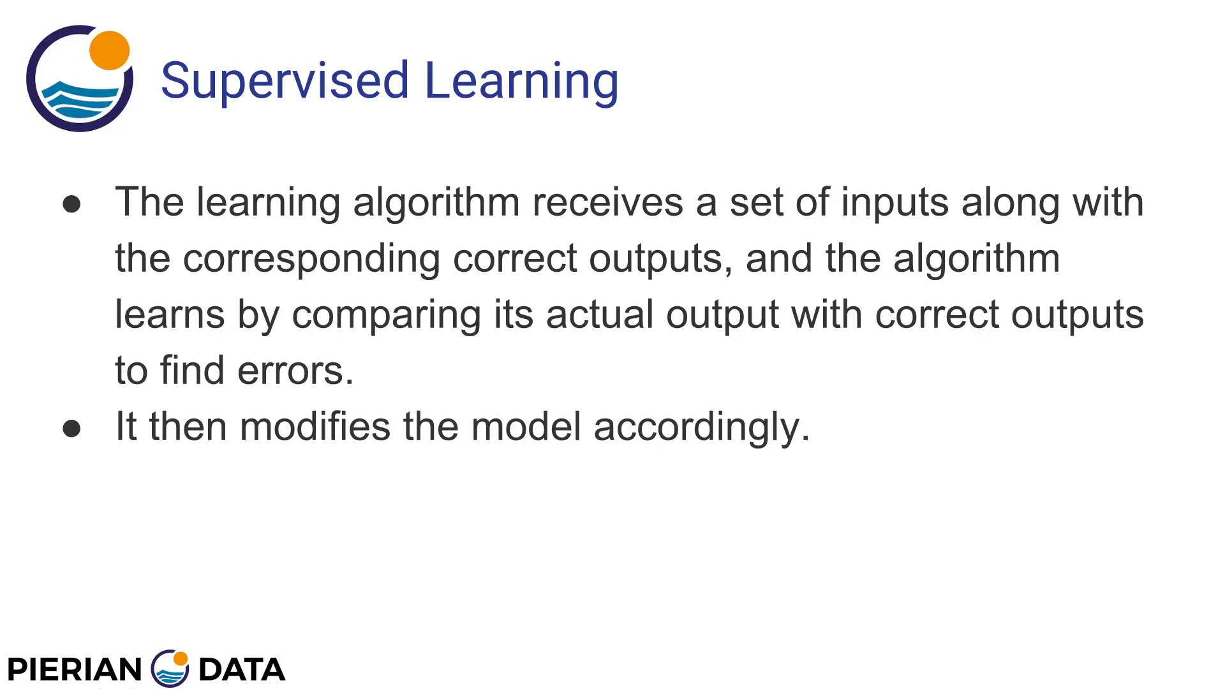
Supervised Learning

Slide 6
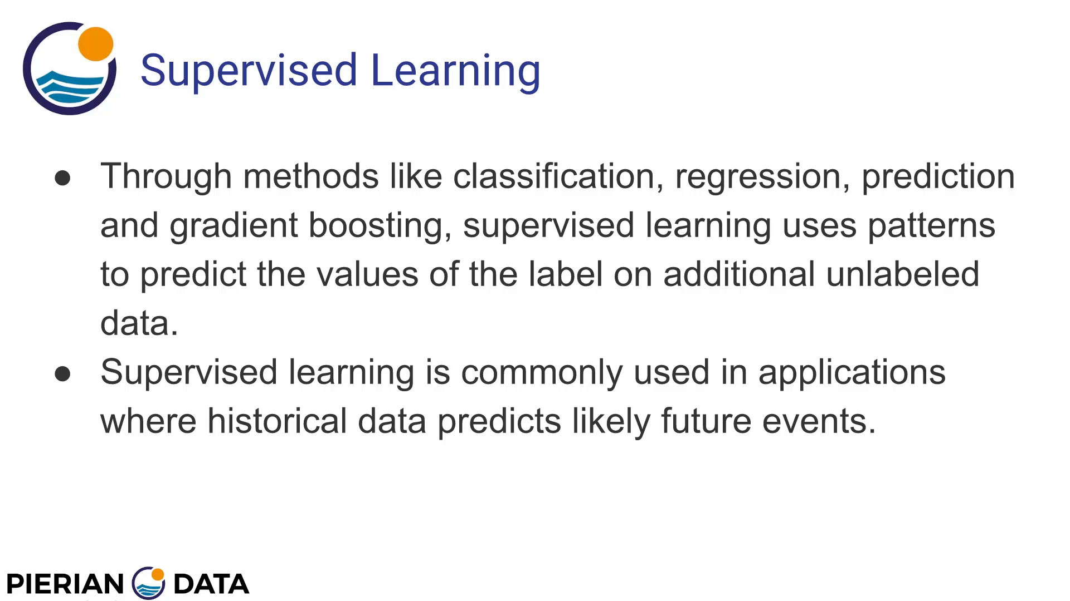
Supervised Learning

Slide 7
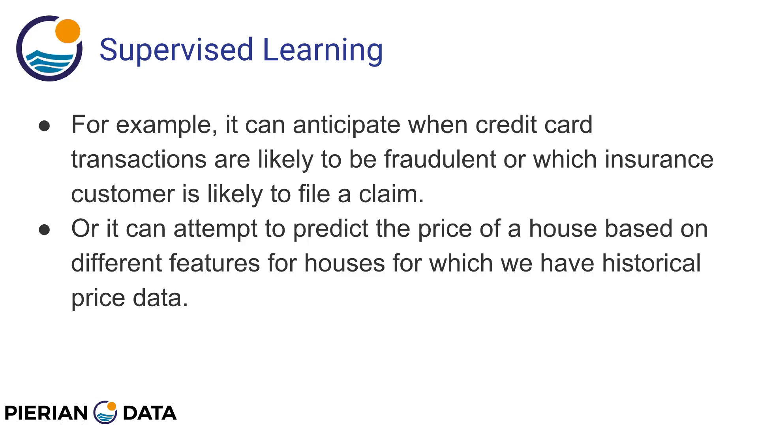
Supervised Learning

Slide 8
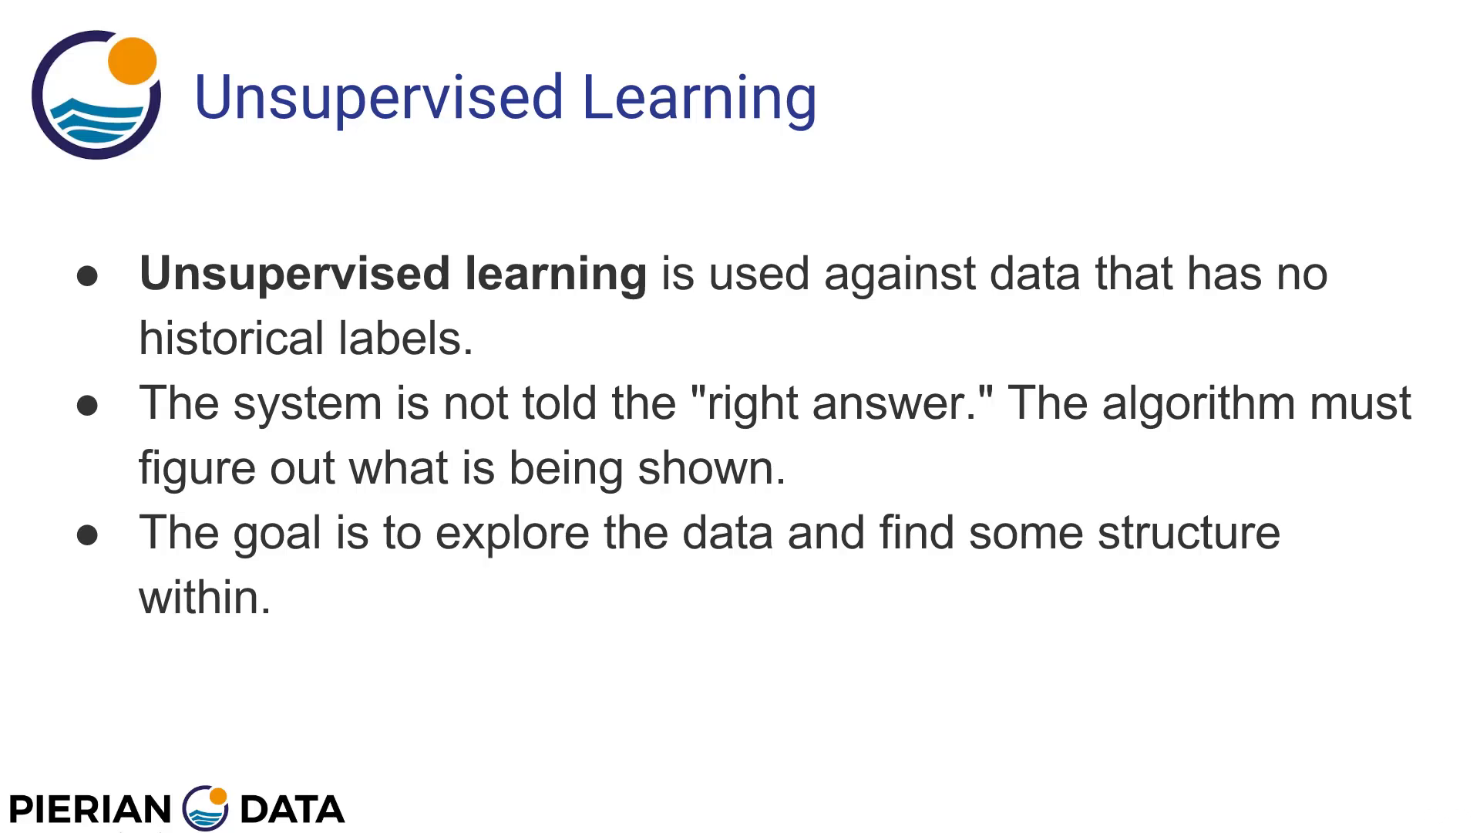
Unsupervised Learning

Slide 9
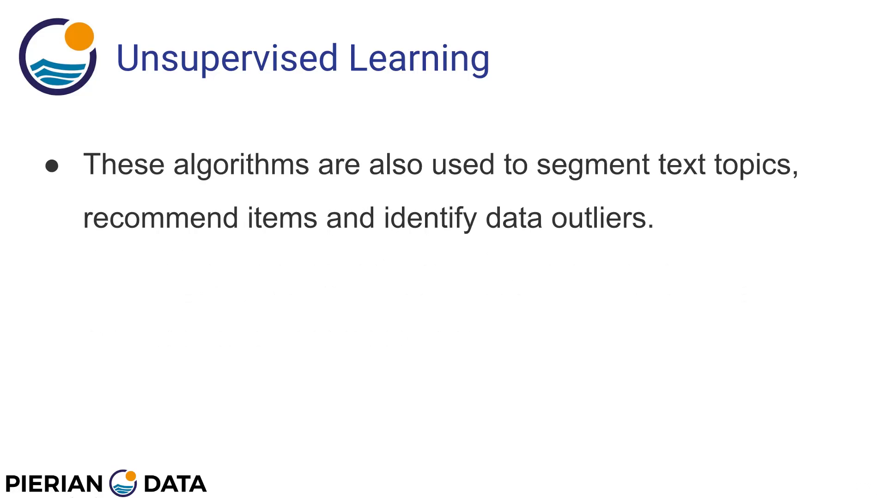
Unsupervised Learning

